Slide 1

Handwriting Recognition using CNN and RNN
Name: Sarnalika Paul
Reg no. : 23122130
Class: MscdsB
Mission
Christ University is a nurturing ground for an individual’s holistic development to make effective contribution to the society in a dynamic environment
Vision
Excellence and Service
Core Values
Faith in God | Moral Uprightness
Love of Fellow Beings | Social Responsibility | Pursuit of Excellence

Slide 2

Table of
CONTENTS
01
02
Data Preprocessing
Introduction
03
04
05
06
17
Model construction
Convolutional Neural Network
.Recurrent Neural Network
Bidirectional LSTM
T
Training and Testing
08
09
10
User Friendly Application
Experimental Results
Conclusion

Slide 3
1
INTRODUCTION
A HANDWRITING RECOGNITION MODEL IS BUILT USING MACHINE LEARNING CONCEPTS. ALTHOUGH SOME STUDIES HAVE BEEN CONDUCTED IN THIS FIELD, MOST ONLY FOCUS ON RECOGNIZING BLOCK SCRIPTS WRITTEN IN CERTAIN LANGUAGES AND TEND TO HAVE VERY LOW ACCURACY WHEN PREDICTING CURSIVE HANDWRITING . TO COMBAT THESE SHORTCOMINGS, THE PAPER PROPOSES AN INTRICATE NEURAL NETWORK CONSTRUCTED WITH CRNN, MAKING IT INCLUSIVE TO ALL HANDWRITINGS. This application will have an easy-to-use user interface and options to save documents and make changes to existing documents

Slide 4
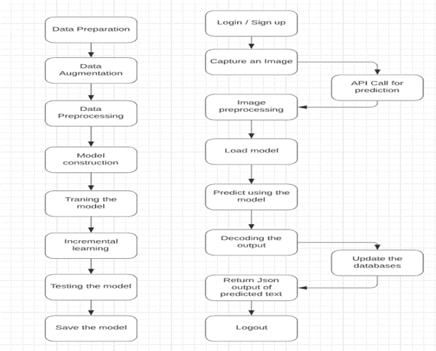
2

Slide 5
AN OFFLINE IAM DATASET, CONTAINING MORE THAN 100,000 IMAGES OF WORDS, FOR TRAINING OUR NEURAL NETWORK MODEL. THE IMAGES ARE OF DIFFERENT SIZES, THEREBY NEEDING TO CONDUCT IMAGE PREPROCESSING BEFORE STARTING THE PROCESS OF TRAINING. DATA AUGMENTATION BY CHANGING BRIGHTNESS AND CONTRAST HELPS TO IMPROVE ACCURACY . IT IS ALSO REQUIRED THAT LABELS ARE CHANGED TO NUMBERS USING THE TENSORFLOW EXPERIMENTAL LAYERS CALLED STRING LOOKUP. THESE LAYERS CONVERT THE LABELS INTO NUMBERS BASED ON THE LIST OF ALL CHARACTERS. THE IMAGES SHOULD ALSO HAVE THE SAME SIZE IN ORDER TO BE ACCEPTED BY THE NEURAL NETWORK
3
Data Preprocessing
AND COLLECTION

Slide 6

4
MODEL CONSTRUCTION
A Keras neural network is formed by blending Convolutional Neural Networks (CNN) and Recurrent Neural Networks (RNN). RNN is crucial for sequential learning, especially with word datasets where sequence matters for accurate text prediction. The network utilizes a modified bidirectional LSTM architecture to combine CNN and RNN functionalities."

Slide 7
5
Convolutional Neural Network
CNN is an artificial neural network used mostly when processing images.

Slide 8
6
Recurrent Neural Network
Bidirectional LSTM
RNN is another type of neural network that utilizes feedback connections
To further improve the accuracy of our model, bidirectional LSTM is implemented in addition to RNN.

Slide 9
7
TRAINING AND TESTING
MANUAL TESTING OF HOW MANY WORDS WERE DETECTED IN THE TOTAL NUMBER OF WORDS PRESENT WAS USED TO FIND THE ACCURACY. TO ENSURE THAT THE BOUNDING BOXES ARE BEING DRAWN PROPERLY.
Accuracy of text detection = Number of words detected accurately / Total words in the image

Slide 10
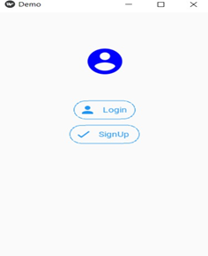
User-friendly application:
Once the handwriting recognition model has been built and tested, an user-friendly application is assembled .
8

Slide 11
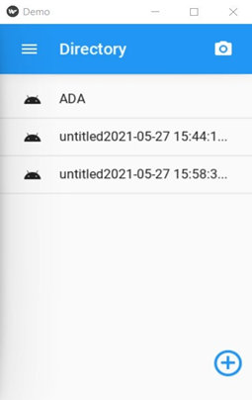
User-friendly application:
After logging in, the user can access their camera from the menu screen to capture and store images of handwritten documents.
9

Slide 12
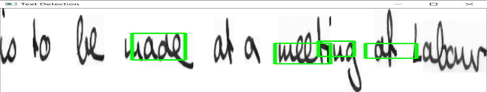
11
EXPERIMENTAL RESULTS
The proposed model, built using CRNN, has highly accurate results with cursive handwritten words as input by making sure to optimize the usage of RAM and time with incremental learning and data augmentation is shown in figure.

Slide 13
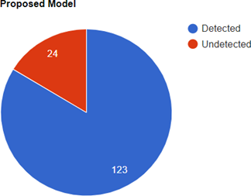
12
The accuracy of the proposed model has been further tested .
This models is tested with the same dataset consisting of cursive handwritten images, which had a total words of 147, in which the proposed system had detected 123 words .

Slide 14
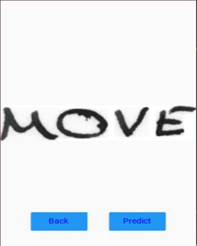
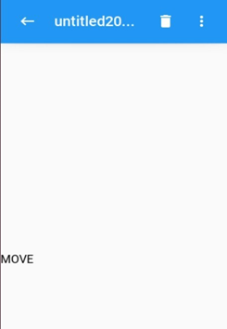
13
THE ANDROID APPLICATION HAS ALSO BEEN SUCCESSFULLY IMPLEMENTED. THE LOGIN SCREEN INFORMS USERS TO ENTER THEIR
CREDENTIALS TO ACCESS THE APPLICATION. THE CAMERA CAPTURES THE REQUIRED HANDWRITTEN IMAGE TO BE PROCESSED BY THE
MODEL. THE MAIN SCREEN OF THE APPLICATION STORES PREDICTED OUTPUTS FROM IMAGES, UPLOADED WITH THE HELP OF THE ‘+’

Slide 15

14
CONCLUSION
IN SUMMARY, THIS PAPER SUCCESSFULLY INTEGRATES MACHINE LEARNING INTO ANDROID APP DEVELOPMENT, CREATING A USER-FRIENDLY HANDWRITING RECOGNITION APPLICATION. BY EMPLOYING ADVANCED ALGORITHMS LIKE CNN AND LSTM, USERS CAN CONVERT HANDWRITTEN CONTENT INTO EDITABLE DIGITAL FILES, REDUCING PHYSICAL DOCUMENT STORAGE AND ENABLING EFFORTLESS EDITING. THE INCLUSION OF FLASK FOR SERVER-SIDE OPERATIONS ENHANCES THE SYSTEM'S FUNCTIONALITY, HIGHLIGHTING THE POTENTIAL OF INTERDISCIPLINARY APPROACHES TO ADDRESS PRACTICAL NEEDS.

Slide 16

REFERENCE
[1] PREMANANADA, R., ET AL. "DESIGN AND IMPLEMENTATION OF AUTOMATED IMAGE HANDWRITING SENTENCES RECOGNITION
USING HYBRID TECHNIQUES ON FPGA." 2020 THIRD INTERNATIONAL CONFERENCE ON MULTIMEDIA PROCESSING,
COMMUNICATION & INFORMATION TECHNOLOGY (MPCIT). IEEE, 2020.
[2] ROSYDA, SALMA SHOFIA, AND TITO WALUYO PURBOYO. "A REVIEW OF VARIOUS HANDWRITING RECOGNITION METHODS."
INTERNATIONAL JOURNAL OF APPLIED ENGINEERING RESEARCH 13.2 (2018): 1155-1164.
[3] HAMID, SITI SUHAILA ABDUL, ET AL. "DYSLEXIA ADAPTIVE LEARNING MODEL: STUDENT ENGAGEMENT PREDICTION USING
MACHINE LEARNING APPROACH." INTERNATIONAL CONFERENCE ON SOFT COMPUTING AND DATA MINING. SPRINGER, CHAM,
2018.

Slide 17
THANK YOU

